Slide 1
AI Computing
Trends - Challenges - Innovations

Slide 2
1
AI Industry Trend Analysis
2
AI Challenges and Innovations
Notes:
This presentation is organized in two sections.
First, we will analyze industry trends of AI, and then we will talk about how Inspur continuously innovates to meet these challenges.

Slide 3
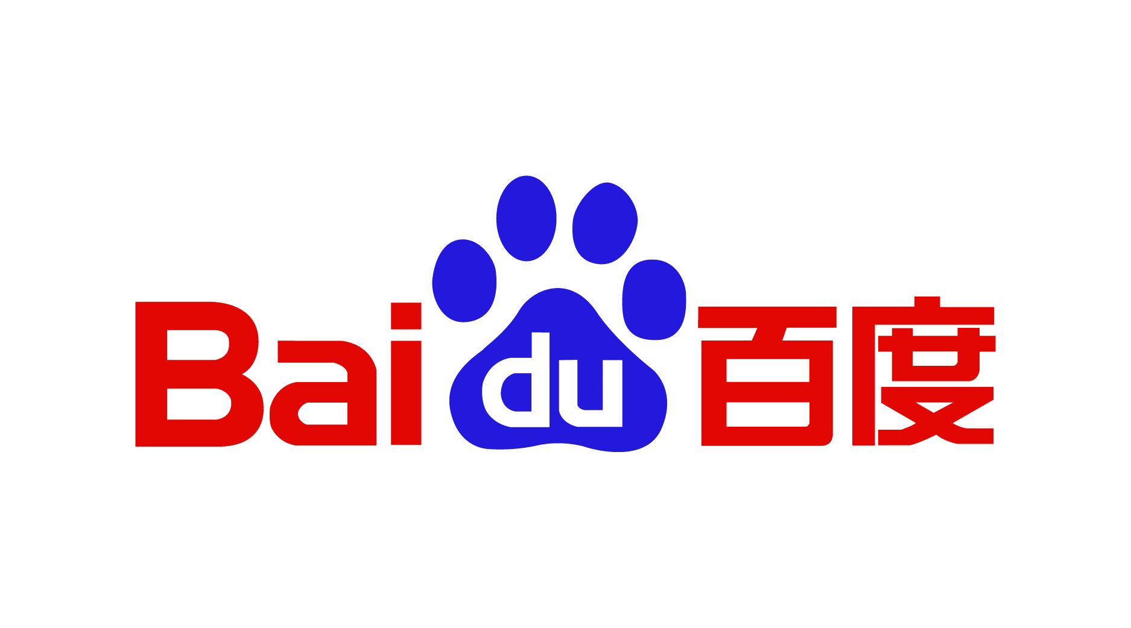
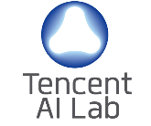
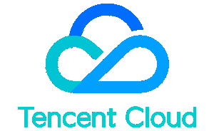
Computing: Foundation for the Development of AI Industry
Algorithm
Application
Facebook
AI Research
Chip
Cloud
Horizon Robotics
Baidu Cloud
IBM Cloud
Computing
The core that facilitates and advances the development of the entire AI industry!
Notes:
First, let’s have a global picture of the AI industry. We can identify four territories in this complex landscape. On the left are positioned the chip providers like Intel and Nvidia. At the top are companies that provide Algorithms and Software applications, and on the right layer are the Internet Service Providers, (such as Amazon cloud, Microsoft Azure, Baidu Cloud, Alibaba Cloud, Tencent Cloud, etc.), which provide the cloud services to the end users. The role of AI server & infrastructure providers at the center core (like Inspur) is to interact with all three outer layers to deliver calculation power and infrastructure support needed to provision complex AI applications. It is obvious that it is this core that facilitates and advances the development of the entire AI industry.

Slide 4
Inspur: Leading AI Computing
Inspur Full-Stack AI System
End-to-End AI Solutions
Vertical AI Solutions
Optimized Frameworks
Caffe-MPI
TensorFlow-Opt
Comprehensive
Management Suite
AIStation
T-Eye
Leading AI Computing
Platform
GPU Server
CPU Server
FPGA Accelerator
Notes:
As global manufacturer, Inspur has been fully engaged in the design and development of a full AI stack in four layers. It includes a comprehensive computing platform of the most advanced technologies, a complete management & performance suite, many modern deep learning frameworks carefully optimized to deliver end-to-end, agile, and cost-efficient AI solutions for its industry customers. Currently, Inspur AI market share is more than 51% and much higher than the other domestic and foreign competitors.

Slide 5
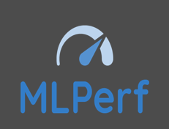
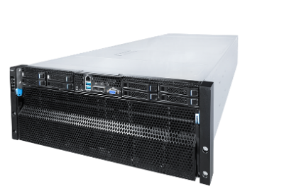
Inspur: Leading AI Computing
Rank | Vendor | Server | CPU | CPU | GPU | ResNet 50 Performance (minutes）
1 | Inspur | NF5488A5 | AMD EPYC 7742 | 2 | A100-SXM4-40GB (400W) | 33.37
2 | NVIDIA | DGX2H | Intel Xeon Platinum 8174 | 2 | V100-SXM3-32GB (450W) | 35.25
3 | NVIDIA | DGXA100 | AMD EPYC 7742 | 2 | A100-SXM4-40GB (400W) | 39.78
4 | Alibaba | HJBOG | Intel® Xeon® Platinum 8269CY | 2 | A100-SXM4-40GB (400W) | 40.49
5 | Fujitsu | GX2570M5 | Intel® Xeon® Platinum 8268 | 2 | V100-SXM3-32GB (300W) | 68.82
6 | NVIDIA | DGX1 | Intel® Xeon® E5-2698 v4 | 2 | V100-SXM2-16GB (300W) | 71.28
7 | DellEMC | DSS8440 | Intel® Xeon® Gold 6248 | 2 | V100S-PCIe-32GB (300W) | 78.54
8 | DellEMC | C4140 | Intel® Xeon® Gold 6148 | 2 | V100-SXM2-32GB (300W) | 154.04
9 | Intel | - | Intel® Xeon® Platinum 8380H | 8 | - | 1104.53
2x AMD EPYC CPU , PCIe Gen4
1st Rank in MLPerf v0.7 Performance Resnet50 Benchmark, ~20% higher than other A100 system
8x NVidia A100 GPU
2020/07/29 MLPerf v0.7 Released
32x 64G DDR4-2933
Break 18th World records in MLPerf v0.7 Resnet50 Inference scene.
4* 3.2T NVMe SSD
NF5488A5
2020/10/22 MLPerf v0.7 will release
Notes:
In addition，Inspur is also leading AI computing power. Inspur's latest super AI server NF5488A5 broke MLPerf records many times. Specifically, Inspur NF5488A4 is 1st Rank in MLPerf v0.7 Performance Resnet50 Benchmark, ~20% higher than other A100 system; and breaks 18th World records in MLPerf v0.7 Resnet50 Inference scene.

Slide 6
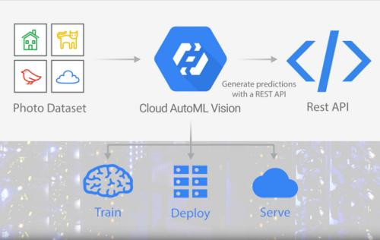
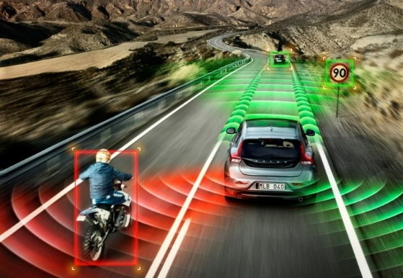
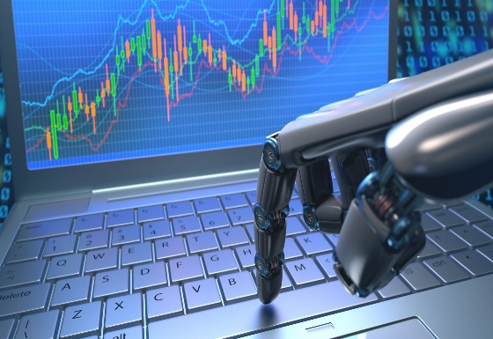
Trends in the Development of AI Industry
Shorten AI application R&D cycle Improve innovation efficiency
Accelerate AI application launch Reduce operational CAPEX
AI and IT infrastructure integration & operation
AI fast empowerment accelerate the
traditional industry AI transformation
Notes:
While providing a solid foundation for the rapid growth of the commercial AI business, Inspur also does not lose sight from the emerging trends in AI industry development. In general, at this time we can identify four major trends:
The first one is about the fierce emergency to accelerate the AI innovations, to shorten their R&D cycle and improve the overall efficiency of the efforts.
The second is obviously about the business deployment of mature AI technologies and reducing the OPEX and CAPEX for bringing them online, which is becoming a growing concern in the industry
The third, as new AI products and solutions are introduced, they cannot operate in isolation from the existing IT infrastructure, but should be fully integrated and operate a part of unified AI and IT converged infrastructure
The last one is about the radical impact of the AI applications in accelerating the digital transformation of traditional industries.
Let's look at each of them.

Slide 7
Trend 1: AI Innovation Speed Becomes Competitiveness Core
COMPUTING POWER
AI TRAINING
MODELS/ALGORITHMS
New development of models and algorithms require exponential compute power increase
Faster growth in computing power translates to faster AI R&D cycles!
Notes:
Trend #1 is related to the R&D stage. Enterprises need to shorten the R&D cycle as much as possible and improve efficiency to be able to gain competitiveness edge. As shown in the above graphs, this is particularly crucial for the technical companies that need to accelerate and shorten the AI training.
With the development of the new AI models and algorithms, the demand for higher computing power is increasing exponentially, which in turn is facilitating the raise of Automatic Machine Learning (AutoML). Before, it may have taken a few months for highly experienced experts to complete the parameter adjustment and optimization process of a neural network model. Now with AutoML , we can find the most suitable model in much shorter timeframe which greatly reduces the development time!
The goal is to replace human mental power with the machine computing power, but the challenge is very big. The example in the center is about the human designed ResNet model that took 256 hours for a single GPU to complete the training, or one hour for 256 GPUs. However, if Google NasNet AutoML is used, would need nearly 8 times of computing power to complete the training.
It is obvious that faster growth in computing power translates to faster AI innovation and development!

Slide 8
Trend 2：AI Business Implementation Acceleration
Voice Assistant
Smart Speaker
NLP
AR/VR
400 million/month
Voice Wake Up Times of DuerOS
>5 million
Annual Shipments of Tmall Genie
409 billion times / day
Numbers of Baidu Brain Calls
> 1 billion
Number of SenseAR Terminal Users
Face Recognition
Autonomous Driving
Smart Retail
xPU
Large-scale Applications
Super Counter, Face Scan Payment, , New Retail,
“Face Scanning” Check-in, Baby Come Home
400+
Passenger numbers of free self-driving
taxi test provided by Waymo
Waymo plan to charge later this year
>100 billion
Smart retail market will be more
than 100 billion in China
Various manufacturers
AI-oriented FPGAs and custom chips
Notes:
Trend 2: AI Business implementation acceleration:
The second trend is about the process of AI commercial deployment being accelerated, particularly for applications like image recognition, voice recognition, and NLP.
For example, the Baidu brain has been frequented more than 400 million times a day, the annual shipments of Tmall genie exceeded 5 million units, Baidu NLP had 409 billion calls per day, and so on….
As a result, it triggered a huge demand for computing power, and Inspur GPU shipments was increased significantly, along with many AI-oriented FPGA and customized chips.

Slide 9
Trend 3：Convergence of AI with IT Infrastructure
Microsoft deploys network virtualization of FPGA acceleration architecture for large-scale processing in FPGA cloud, flexible and scalable Hardware & Software architecture
Reduced enterprise access costs
Intelligent robot remotely supported and updated, virtual intelligent assistant inference applications are supported and updated through the powerful cloud platform with AI / DL technologies in the background.
Cloud platform
Baidu's powerful cloud database technology supports the Apollo research program and realize the development of DuerOS system.
Alibaba Cloud combines the system and algorithms to achieve the fastest model building with AI technology, supports multi-person simultaneous development, A / B test
More data sharing, more intelligent AI
Notes:
The third major trend is the convergence of AI with IT infrastructure. At the initial stage of AI innovation and development, a single GPU server may be sufficient. However, later in the process when AI becomes an indispensable part of enterprise R&D system, it will be necessary to integrate AI into the existing IT infrastructure. If AI remains outside the IT infrastructure, it will be difficult to manage innovation efficiency. The trend of AI+ Cloud platform combination just address this problem, which also can reduce the access cost, and the open data sharing can make AI even more intelligent.
On the left are just some examples from the recent development in the industry, which demonstrate how the AI convergence with IT infrastructure is becoming a differentiator that can improve the company business efficiency, accelerate the decision-making and improve the customer service.

Slide 10
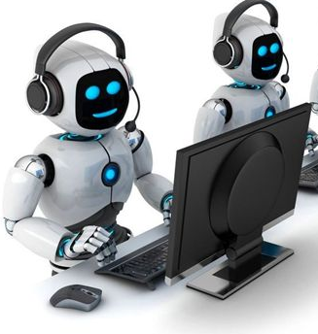
Trend 4：Acceleration of Traditional Industry AI Transformation
AI Enabled Virtual Customer Assistant
AI Enabled Policy Engine
AI Enabled Medical System
Suning AI Customer Service
Citic Securities AI Policy Engine
Philips AI Intelligent Diagnosis
200 million members, accuracy rate reaches 92%
10X quantitative trading strategy generation efficiency
Lung nodule detection error rate<1%
Notes:
The fourth trend is about AI accelerating the digital transformation of traditional industries. AI is no longer the patent or monopoly of Internet companies, but began to empower the traditional industries, bringing drastic improvement in their efficiency.
For example, Philips’ AI intelligent diagnosis can reduce the of lung nodule detection down to less than 1% error rate.

Slide 11
1
AI Industry Trend Analysis
2
AI Challenges and Innovations
Notes:
The four trends that we just discussed present new challenges for AI computing, so next we will have a look how Inspur is responding to these challenges with innovations.

Slide 12
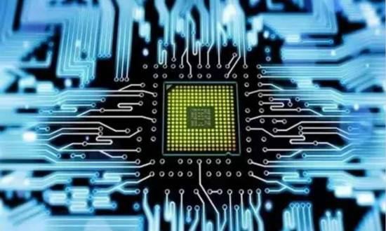
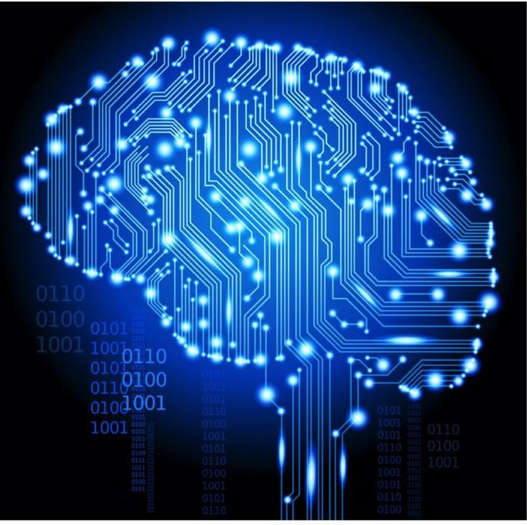
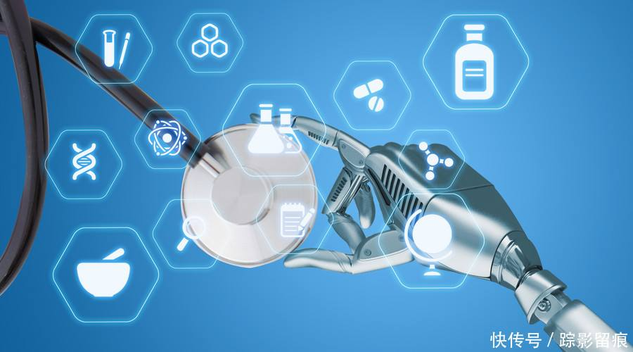
Challenges for AI R&D and Innovation
Server Computing Power
Accelerator Interconnection
DL Model Development
Resource Optimization
Demand for AI computing power grows rapidly, current AI servers do not meet the requirements.
DL performance requires more GPUs in single server, higher bandwidth connectivity between the GPU servers.
DL models requires higher performance then servers can provide. DL models & algorithms need to be improved.
Investigate and alleviate the performance bottleneck during training, improve the overall system resource efficiency
Notes:
Facing the challenge of improving the efficiency of AI R&D innovation, enterprises generally pay attention to three aspects:
One is about shortening the R&D cycle.
Two is the Throughput, which indicates the flux of how many models can be studied at one time. Of course, by studying 100 models at a time, for sure you will be much more efficient than somebody else that can do for example just two.
Third - Capability, which becomes a differentiator for something you can do, and others can’t, and your research and development will have a definitive edge to be more efficient.
With the Deep Learning models’ complexity increase, AI computing faces more and more challenges. Therefore, we urgently need to improve cluster computing performance through fast interconnected accelerators and resource optimization, improve the speed and accuracy of model training, and the efficiency of AI R&D innovations.

Slide 13
Challenges of AI Integration into Cloud Computing
Maximize AI computing efficiency on cloud platform
AI software evolves fast, difficult to be updated in the cloud stack
Heterogeneous AI computing has become a mainstream trend, cloud platform has to be fully compatible
With AI training data explosion, cloud platform computing and cloud storage performance have to be improved simultaneously
Notes:
Besides, the challenges just mentioned, what I want to talk about today is the challenge of integrating AI into cloud computing, which is the most popular challenge in the AI industry.
The integration of AI into cloud computing, which needs to resolve the following problems:
How to integrate AI into public and / or private cloud IT infrastructure,
How to effectively use heterogeneous AI resources in the cloud,
How to effectively manage and utilize the cloud resources to maximize the efficiency of AI computing, etc.

Slide 14
Inspur AI OpenStack Private Cloud Platform
Key Characteristics
Converged Cloud + AI infrastructure
Flexible heterogeneous cloud environment
Extremely simplified AI cluster management
AI model
Training layer
Data management
Model development
Model training
Model Visualization
AI Station
TensorFlow
CNTK
PaddlePaddle
Efficiency Improvement
Fast AI development
Frame mirroring
Packaged delivery
AI
resources
Management
GPU
Scheduling
GPU
Management
GPU
Monitoring
Docker Mirroring
Management
Cloud Platform
OpenStack
Computing resource
Storage Resource
Internet Resources
Physical Resource Layer
CPU
Server
GPU/FPGA
Server
Distributed
Shared
Cloud storage
10G network
IB Network
Notes:
The Inspur's innovative solution is Inspur AI OpenStack Private Cloud Platform and AI Station management platform.
For enterprises to build private clouds Inspur offers a solution based on OpenStack and enhanced it to run its PaaS AI Station management platform.
Thus, making it very convenient for OpenStack cloud users to take full advantage of the AI station management suite optimized for the AI R&D process, including package integration delivery, which remarkably improves the efficiency of AI application innovation.

Slide 15
Inspur AI Station + OpenStack Cloud Platform Example
Computing Resource Pool
Data management
PaaS
Resource pooling, fine scheduling, resource utilization increased 3X 1000+CPU/GPU Docker resource pooling and isolation Load balance, scheduling on demand
Unify cloud storage, integrate data flow, improve data flow efficiency High performance cloud storage system Linked data processing, labeling, standardization, training, etc. Provide training data read-ahead and caching mechanism
With dozens of algorithm groups, and more than 100 developers, the training model size increased 3 times Lightening speed deployment of deep learning development platform Quick start network model training task Full deep learning training service
Notes:
In this use case, we have been able to:
Manage over a thousand GPU devices in Openstack cloud,
Increased their original utilization rate from 30% to 80%,
Supported simultaneous use of several hundred developers,
Increased the volume of the AI training model three times.

Slide 16
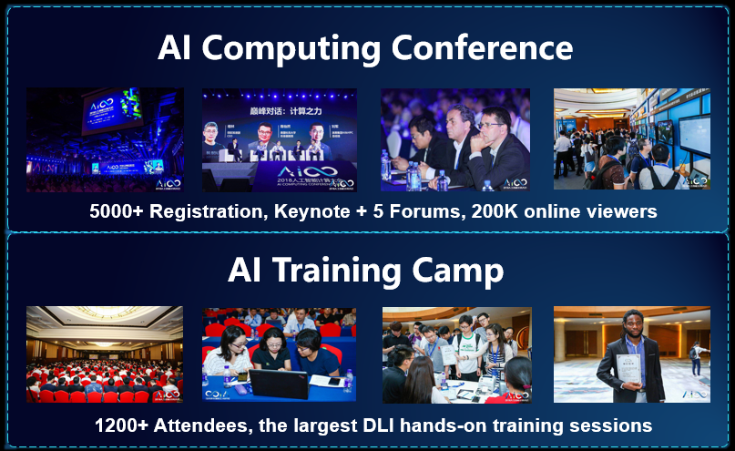
Building up the AI Ecosystem
Notes:
Moreover, Inspur remains committed to cultivating the industrial AI ecosystem and AI talents.
Last year, Inspur hosted the third AICC AI computing conference to build an international platform for advanced AI exchanges and promote innovation and cooperation in AI technologies.
In regard of AI talent cultivation, in the first day of the AICC conference, Inspur organized the AI training camp, which this year set the record by attracting more than 1,000 participants, At the same time, together with the ASC world's largest supercomputing competition, Inspur has trained more than 5,000 college students and engineers each year.
On the other hand, in the recent AICC conference Inspur issued the “China AI Computing Power Development Report”, which includes a comprehensive assessment of investment and supply, by industry and region, by demand and applications. It provides the scientific basis for research institutions and commercial companies to create their own vision for AI development & trends and formulate their own AI development strategy, customized to their needs.

Slide 17
Summary
Accelerating R&D Innovation
Inspur
AI Computing
Optimizing Business Operation
Leveraging Cloud Infrastructure
Shaping Industry Ecosystem
Notes:
Finally, in facing the four major trends of AI computing:
Inspur will continue to innovate, cooperate with partners to accelerate R&D efficiency and innovation,
Reduce the operation cost for bringing the AI solutions online,
Integrate AI with cloud computing,
Bear a substantial responsibility for creating the AI ecosystem in the industry.
Inspur will continue to contribute in the advancement in AI computing, promote the development of the AI ecosystem, and expand AI application adoption in industry, academia and scientific research.

Slide 18
Thank you

