Slide 1

National Priority
AI for Smart City
Smart Mobility & Government.
Prof. Suhono Harso Supangkat
Smart City & Community Innovation Center ITB
University National Center of Excellece

Slide 2

City: a system of physical structure, living entities, interaction and information.

Slide 3


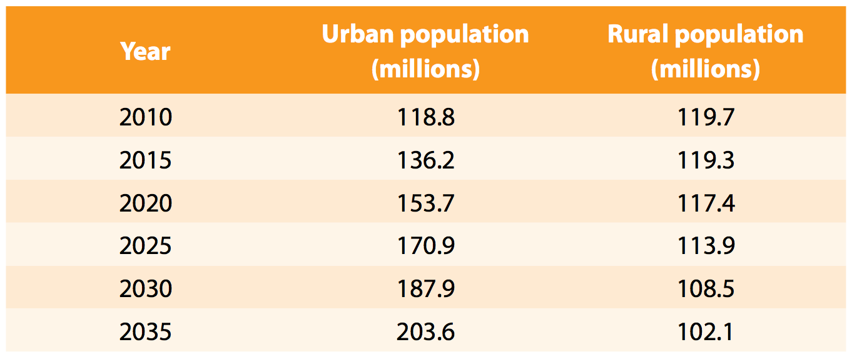
Urbanizatiom : Urban vs. Rural
http://www.un.or.id/counter/download.php?file=policy_brief_on_the_2010_2035_indonesian_population_projection.pdf

Slide 4
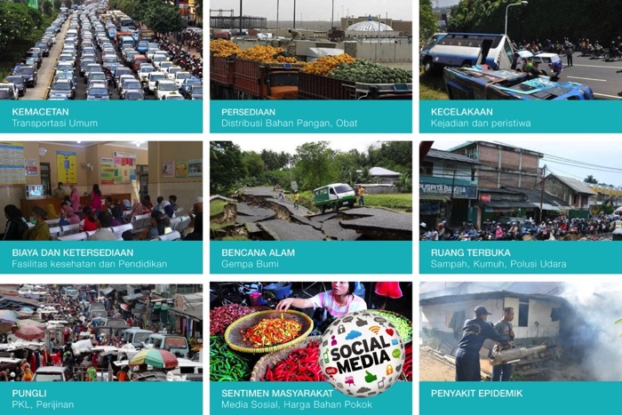
City Challenges

Slide 5

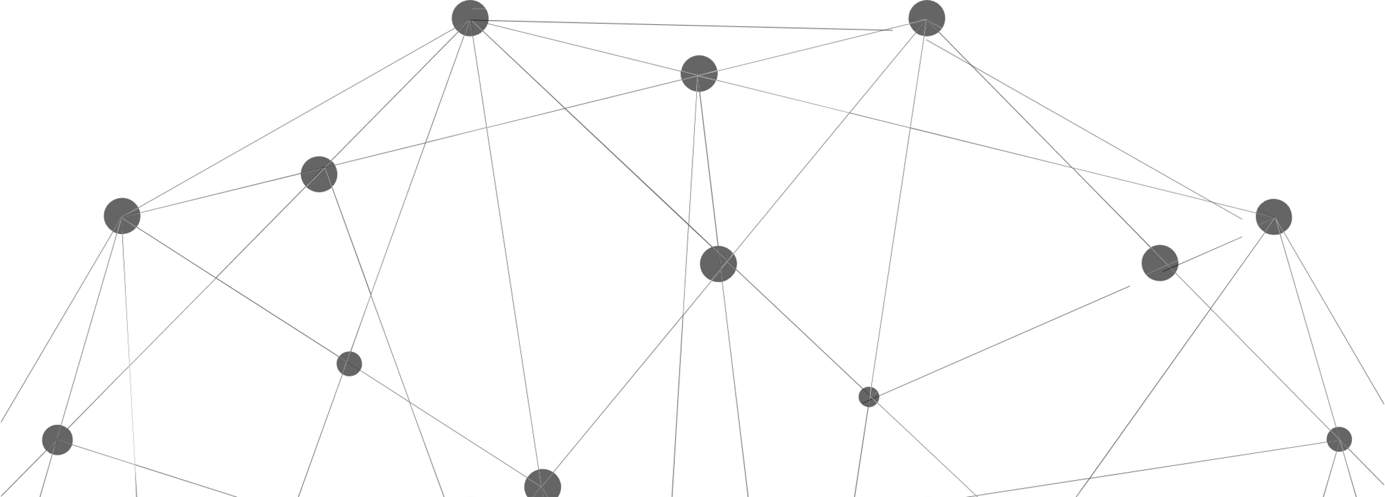
Urban Mobility Challenge
Traffic Congestion
Public Transport Crowding
Public Transport Coverage
Environmental impact and energy consumption
Difficulties of pedestrian
Lack of accessibility & affordability
Accident and safety
etc

Slide 6
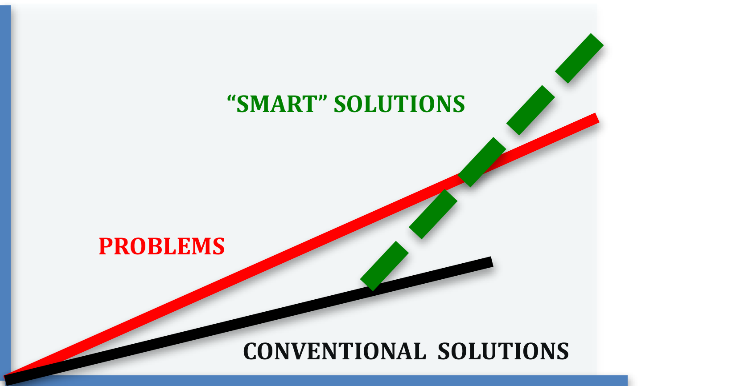
Problem VS Solution
Te
Smart Solution
Technology, Business and Social Disruption :
Internet of Things
Big Data
Cloud Computing
Co-creation
Artificial Intelligence
Social Robotics
Cyber Security
Driverless Car
What (description)
Why (diagnoze)
What will happen (prediction)
What should we do (prescription)

Slide 7
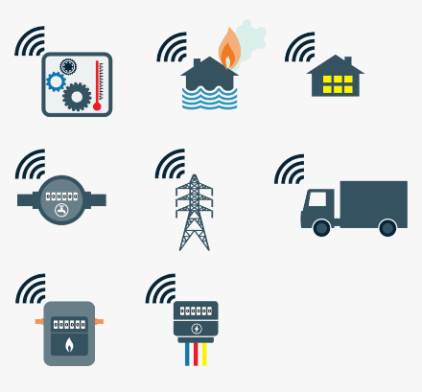





How it works
Sensing
Understanding
Acting
IoT Sensors
Data Analytics
Reporting and Notification
ISSP DataHub
Device Controlling
Decision Support System
Artificial
Intelligence
Data Visualization
Social Media and Websites

Slide 8
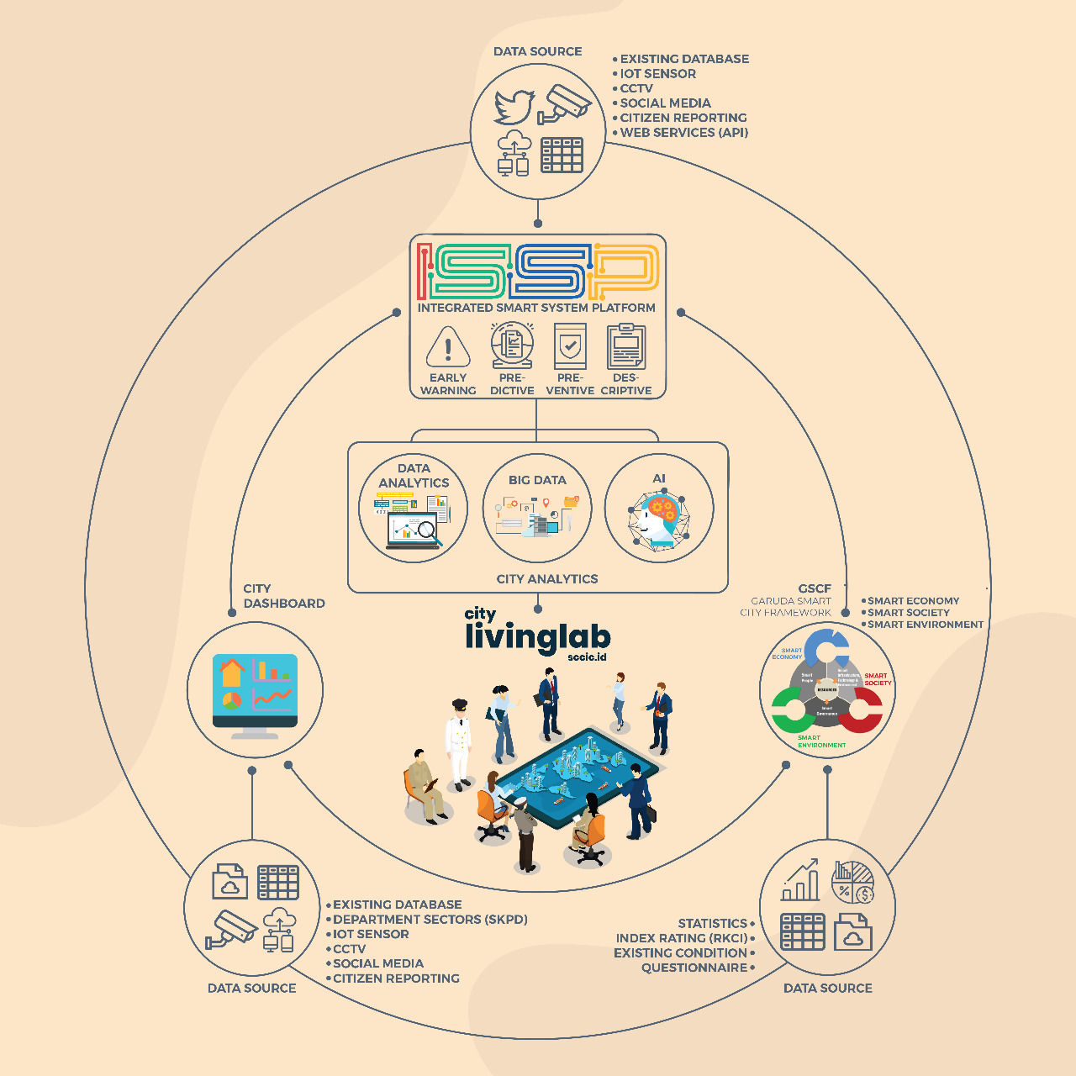
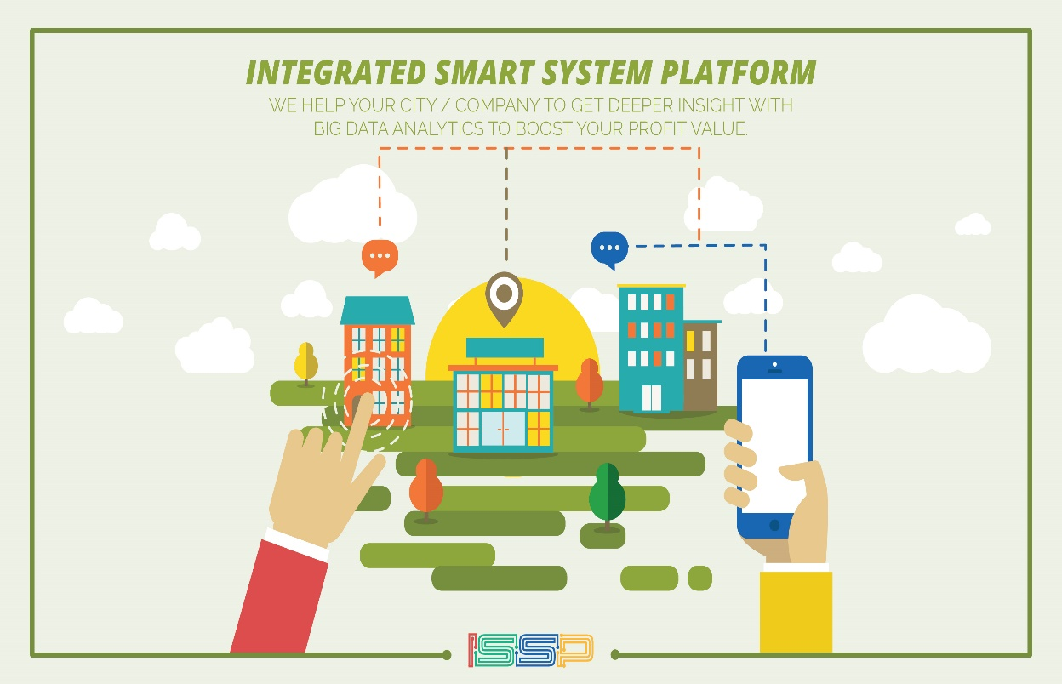
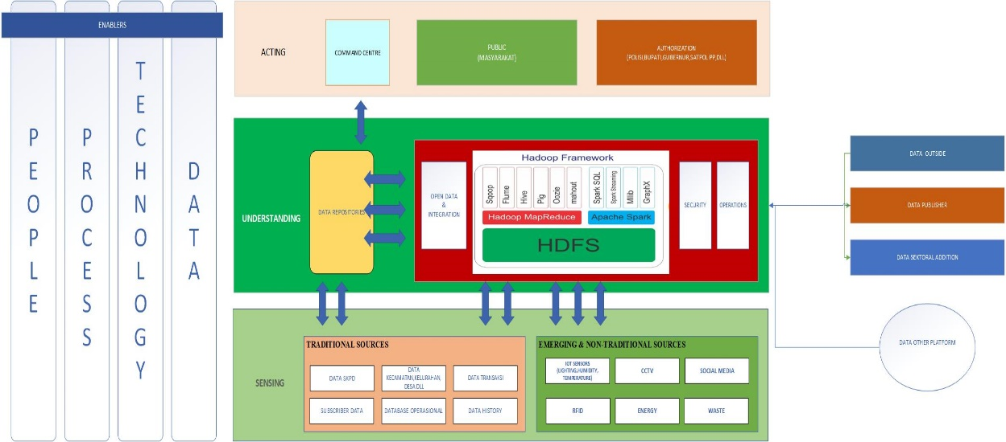
Integration & Collaboration Platform

Slide 9
Smart City Definition :
Smart City
Smart City is a city that can utilize its resources effectively and efficiently to solve any city challenges using smart solution by providing infrastructures and deliver city services to improve Quality of Life.
Smart City is not City + Technology
Smart City
People
Technology
Process
“City that know the internal problems (sensing), understand the problem (understanding) and able to organize resources effectively and efficiently to maximize service to the citizen”

Slide 10
Smart Indonesia
Consists of Smart City, Smart “Kabupaten” (District) and Smart Village
Smart Indonesia
Smart City/District
Smart “Kecamatan”
Smart Village

Slide 11


Connection Between GSCF and (Real) Smart City
SMART CITY
FRAMEWORK
Collaborate
Using
Described as
Architecture by
Standardize by
Conceptually
Implemented by
Measured by
Developed by
Smart City
Definition
Smart City
Model
SC
Measurement
Model
SC
Collaboration
Model
SC
Development
Model
SC’s Enterprise
Architecture
SC’s
Standards
SC
Services
Refer to
Modeled by
Refer to
Refer to
Refer to
Refer to
Refer to
Refer to
Refer to
City EA &
Standard
Government
have
City
Plan
Align to
Refer to
Implement
by
Smart City
Measurement
Measured by
City
(Smart City)
Smart City
Plan
Smart City
Initiative
(Project)
Private
Sectors
have
Private
Plan
Improved
by
Executed
as
Hand over to
Implement
by
Measured by
Measured by
Deliver
Citizen &
Community
Community
Plan
Consumed by
Smart City
Services
Create
Operational
Unit
have
Smart City
Collaboration Forum
Part of
Citizen
Part of
Part of

Slide 12
Smart X Model
Service
Domain
Service
Cluster
Smart Industry
Smart Small Business
Smart & Creative Startup
Smart Tourism
  Service 1
  Service 2
Smart Maritime
Smart Mobility
Smart Payment & Banking
Smart Commerce
others
Enabler
SMART ECONOMY
Service Item
Services
Smart Energy
Smart Water/Air/Land
Management
Smart
Waste Management
Smart
Region Management
others
Smart
Infrastructure,
Technology &
Environment
Smart
People
RESOURCES
Smart Health
Smart Education
Smart Government
(Public Services)
Safe & Secure
Smart Generation
others
SMART ENVIRONMENT
Smart
Governance
SMART SOCIETY

Slide 13



Smart City and E-Government
Face to face
Services
E-GOVERNMENT
SMART CITY
NON-
GOV
DINAS or
Sector
NON-
GOV
DINAS or
Sector
Online
Services
Gov-
Services
NON-
GOV
DINAS or
Sector
Gov-Services
IT-Services
REGULATE
CITY
GOV
City
Government
Institution
DISKOM
INFO
E-Government

