Slide 1
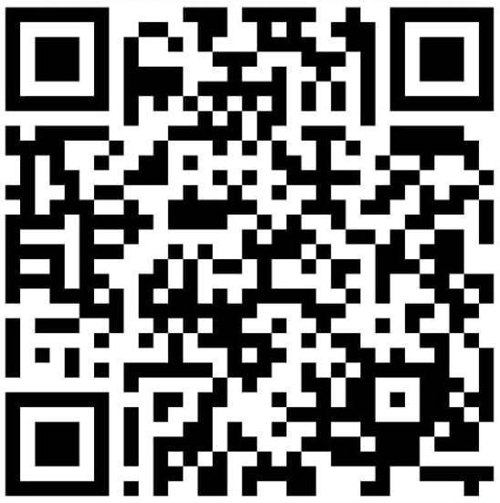
Securing the Future of AI:
Addressing Privacy,
Security, and Compliance in Large Language Models
On Lee CTO of GDP Venture | CEO & CTO of GDP Labs
onlee
onlee@gdpventure.com
onlee@gdplabs.id
Notes:
AIIS - KORIKA - August, 10, 2023. https://bit.ly/3YoDfbQ
Artificial Intelligence Innovation Summit 2023 (AIIS)
KORIKA - Securing the Future of AI: Addressing Privacy, Security, and Compliance in Large Language Models https://bit.ly/3YoDfbQ
This slide is a subset of the slides below
WA group: AIIS-Sesi 2 DigitalGov
Securing the Future of AI: Addressing Privacy, Security, and Compliance in Large Language Models - Google Slides
Title: Securing the Future of AI: Addressing Privacy, Security, and Compliance in Large Language Models
Description: This keynote will delve into the pressing concerns of Privacy, Security, and Compliance in large language models (LLMs). We will explore potential solutions, focusing on fine-tuning for specific domains, Retrieval Augmented Generation (RAG), and built-in privacy, security, and compliance at every level. This talk will provide insights into how we can apply these techniques in highly regulated industries like financial services and healthcare.
World AI Show – Singapore
World AI Show – Singapore Speakers
The Next Billion Programmers: Programming for Everyone Using Prompt Engineering - Google Slides
Digital Transformation Indonesia - Google Slides
Firefly prompt : human robot The Next Billion Programmers, Programming for Everyone Using Prompt Engineering

Slide 2
Application: ABCD-X Technologies
Artificial Intelligence (AI)
Web
Blockchain
What is
ABCD-X
Technologies
Security
Cloud
Mobile
Data
Internet of Things (IoT)
Notes:
Digital Transformation Indonesia - Google Slides

Slide 3
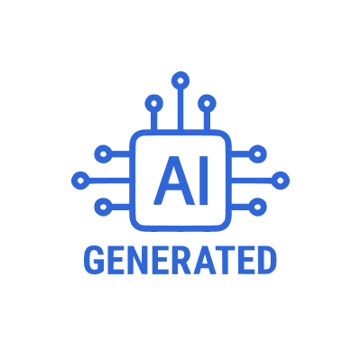
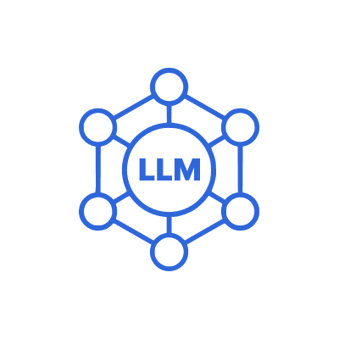
LLM App : ChatGPT
Artificial Intelligence (AI)
Machine Learning (ML)
Deep Learning (DL)
Generative AI (GenAI)
Large Language Model (LLM)
Notes:
Digital Transformation Indonesia - Google Slides

Slide 4
Building
LLM Apps
Notes:
The Next Billion Programmers: Programming for Everyone Using Prompt Engineering - Google Slides
Prompt :”half human robot, coding in front of a laptop, in a room full of technology, warm color, realistic style, ultra rendering, wide 9:16”

Slide 5
Challenges in Government & Regulated Industries
Public
Cloud
English-Centric (>50%)
Public Information
Notes:
LinkedIn “ChatGPT for Bahasa Indonesia” As per Statista's data from January 2023, the most common languages employed for web content, ranked by their share of websites, include English at a dominant 58.8% and Indonesian with a considerably smaller portion of 0.6%.
Most used languages online by share of websites 2023 | Statista
English, 58.8%
The Next Billion Programmers: Programming for Everyone Using Prompt Engineering - Google Slides
Prompt : Very large companies, which use artificial intelligence technology. warm color, realistic style, ultra rendering

Slide 6
APP
Internal LLM and External (Customer Facing) Applications
P R I V A C Y
S E C U R I T Y
C O M P L I A N C E
R
A
G
Vector Database
Text: Word, Power, Excel, Outlook, Google Doc, Google Spreadsheet, Google Slides, GMail, PDF, CSV, SQL, website
Audio: MP3, AAC, WAV, M4A, WEBA, OGG, MP4, MOV, WEBM
Images: OCR, label
API
*RAG = Retrieval Augmented Generation
F
I
N
E
-
T
U
N
I
N
G
Company Private Information LLM [Expert or Veteran]
3
Company Public Information LLM [Specialist]
2
Company Public Information
Government
Regulations
International
Standards
Open Source Large Language Model (LLM) [Generalist]
1
Notes:
Talking points: Train the LLM to become a domain expert on a company and its business lines using government regulations, international standards, and internal data. In other words, we want to make LLM from a generalist to a specialist.
Use open-source LLM[1] as a starting point.
Fine-tune it using company public information, government regulations, and international standards LLM[2].
Further, fine-tune it using Company Private Information LLM[3].
Use Retrieval Augmented Generation (RAG) to retrieve data from outside a foundation model and augment your prompts by adding the relevant retrieved data in context.
Now have 3 LLMs that can be picked and chosen depending on the business requirements: Internal and External LLM applications.
Retrieval Augmented Generation (RAG) - Amazon SageMaker
[2005.11401] Retrieval-Augmented Generation for Knowledge-Intensive NLP Tasks (arxiv.org)
Foundation models are usually trained offline, making the model agnostic to any data that is created after the model was trained. Additionally, foundation models are trained on very general domain corpora, making them less effective for domain-specific tasks. You can use Retrieval Augmented Generation (RAG) to retrieve data from outside a foundation model and augment your prompts by adding the relevant retrieved data in context.
With RAG, the external data used to augment your prompts can come from multiple data sources, such as a document repositories, databases, or APIs. The first step is to convert your documents and any user queries into a compatible format to perform relevancy search. To make the formats compatible, a document collection, or knowledge library, and user-submitted queries are converted to numerical representations using embedding language models. Embedding is the process by which text is given numerical representation in a vector space. RAG model architectures compare the embeddings of user queries within the vector of the knowledge library. The original user prompt is then appended with relevant context from similar documents within the knowledge library. This augmented prompt is then sent to the foundation model. You can update knowledge libraries and their relevant embeddings asynchronously.
Domain-adaptation Fine-tuning of Foundation Models in Amazon SageMaker JumpStart on Financial data | AWS Machine Learning Blog
Although LLMs are capable of performing various NLP tasks, they are considered generalists and not specialists. In order to train an LLM to become an expert in a particular domain, fine-tuning is usually required.
LLM Stack

Slide 7
Strategic Partnership
Providing End-to-End GenAI Solutions through Collaboration with AI Startups, Each Excelling in Their Own Area.
NLP Platform
ABCD-X Solution Provider
Text & Speech Processing for Indonesian & English

Slide 8
Help Us Improve AI
Privacy, Security, and Compliance
We Value Your Feedback
Share your thoughts on our presentation and solutions
Become a Beta User
Join us in testing and refining these solutions
Let's Collaborate
Together, we can shape the future of AI
Notes:
Image prompt : human using black suits shaking hands with half-robot humans full body, working with each other using technology Artificial intelligence , in a room, warm color, realistic style, ultra rendering.

Slide 9
Thank You!
GenAI contributed to slide concepts and created the images.
Paperless: No paper was printed in the making of these slides.
On Lee CTO of GDP Venture | CEO & CTO of GDP Labs
onlee
onlee@gdpventure.com
onlee@gdplabs.id
Notes:
GenAI generated all images.
Paperless: No paper was printed in the making of these slides
FIREFLY PROMPT : HUMAN ROBOT ASK QUESTION AND ANSWER

Slide 10
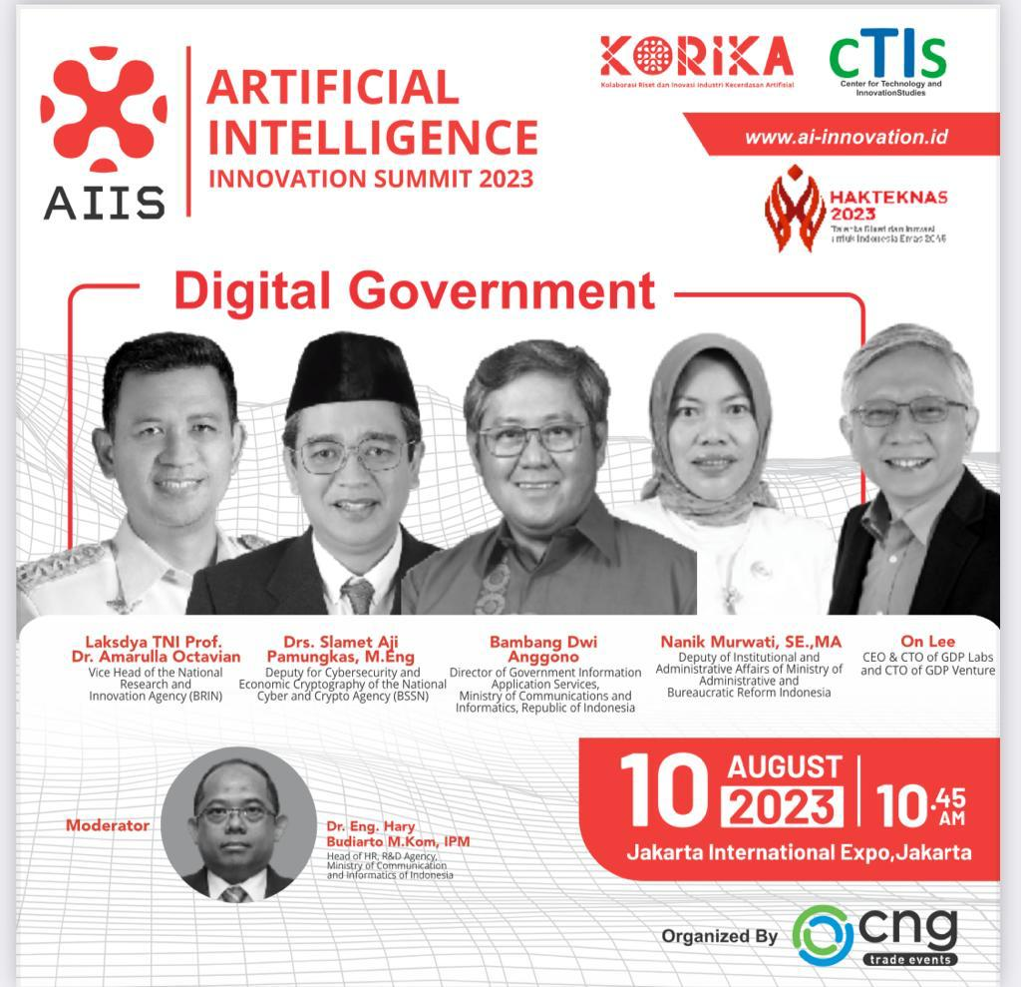
Notes:
AIIS - KORIKA - August, 10, 2023. https://bit.ly/3YoDfbQ
KORIKA - Securing the Future of AI: Addressing Privacy, Security, and Compliance in Large Language Models https://bit.ly/3YoDfbQ
This slide is a subset of the slides below
WA group: AIIS-Sesi 2 DigitalGov
Securing the Future of AI: Addressing Privacy, Security, and Compliance in Large Language Models - Google Slides
Title: Securing the Future of AI: Addressing Privacy, Security, and Compliance in Large Language Models
Description: This keynote will delve into the pressing concerns of Privacy, Security, and Compliance in large language models (LLMs). We will explore potential solutions, focusing on fine-tuning for specific domains, Retrieval Augmented Generation (RAG), and built-in privacy, security, and compliance at every level. This talk will provide insights into how we can apply these techniques in highly regulated industries like financial services and healthcare.
World AI Show – Singapore
World AI Show – Singapore Speakers
The Next Billion Programmers: Programming for Everyone Using Prompt Engineering - Google Slides
Digital Transformation Indonesia - Google Slides
Firefly prompt : human robot The Next Billion Programmers, Programming for Everyone Using Prompt Engineering

